Slide 1
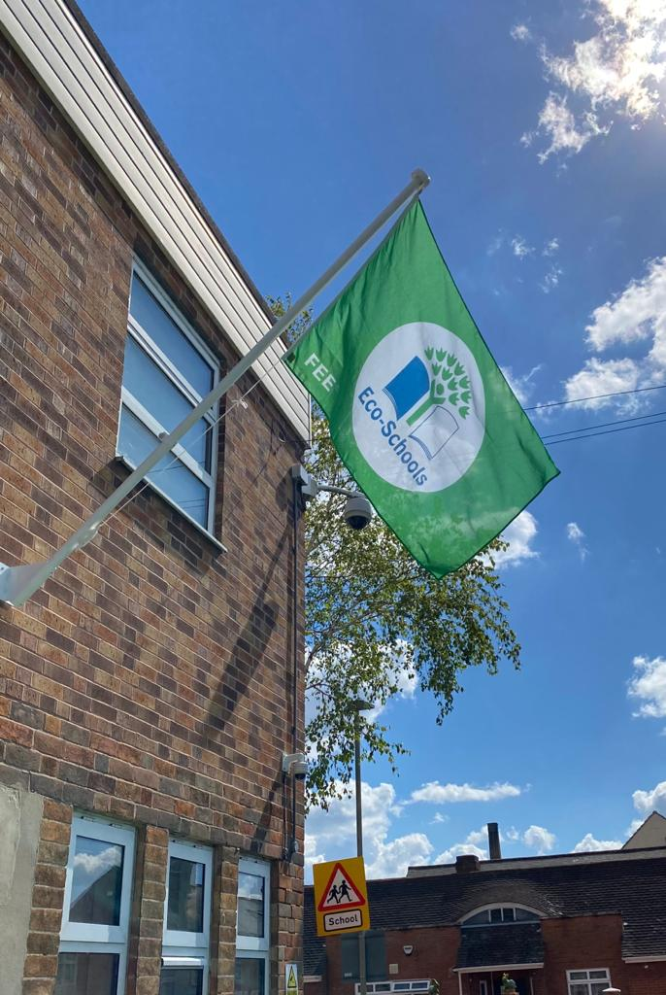
Our Journey to achieving
Green Flag Status

Slide 2
We started by achieving our Bronze Eco-school award

Slide 3
Followed by the Silver Eco-schools award
To progress from our Silver Award to Green Flag Status there were two key areas which our Eco-Committee needed to focus on: 1) Eco Schools topics and 2) Developing an Eco-Code for our school.

Slide 4
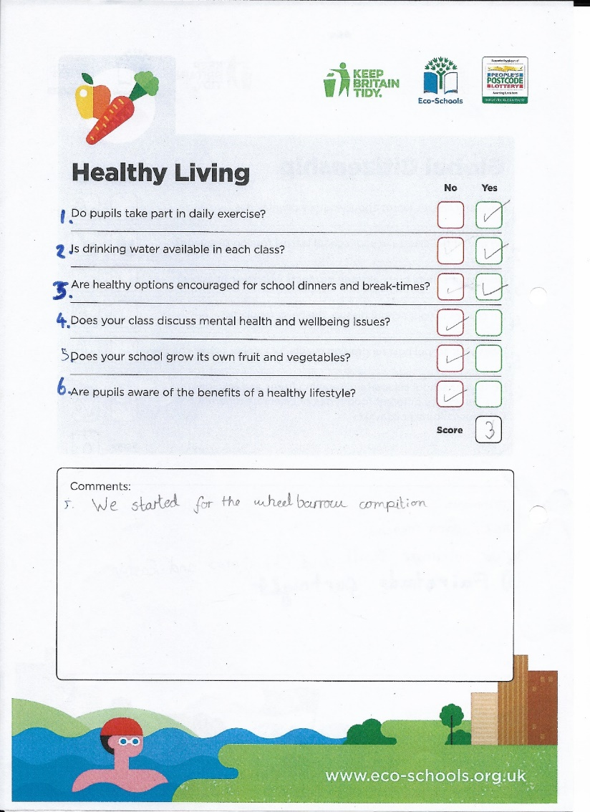
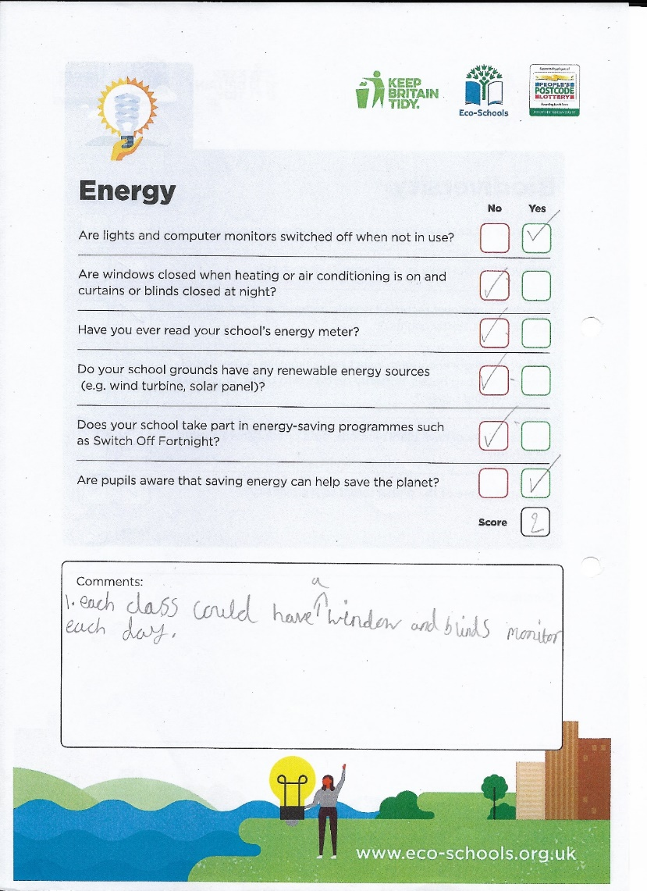
We began by doing
our own environmental review
Our Eco-committee completed an eco-review in order to focus on key topics in our school

Slide 5
Our Eco Schools Topics

Slide 6
Our Eco Schools Action Plan
After focusing on our chosen topics, we began producing an action plan outlining how we would develop each topic area.
Action planning around our chosen topics

Slide 7
Our Eco-committee created their own Eco-code to
promote around school and involved all classes

Slide 8
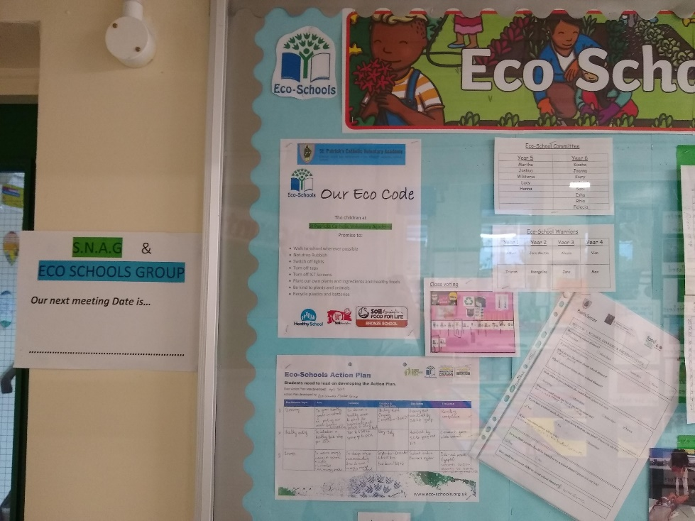
As a group we put together an Eco schools display which we updated regularly and involved other pupils across the school.
Our display was interactive so other pupils could add their own concerns, ideas and suggestions for how we could help our school.

Slide 9
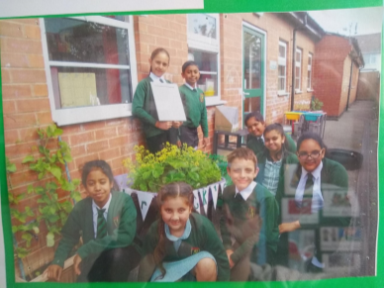
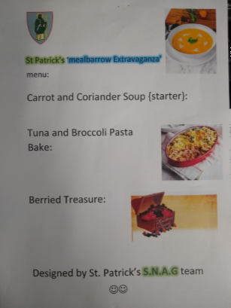
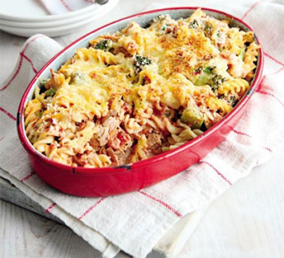
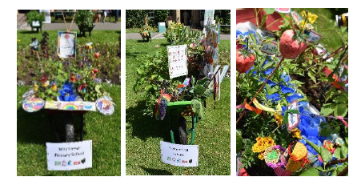
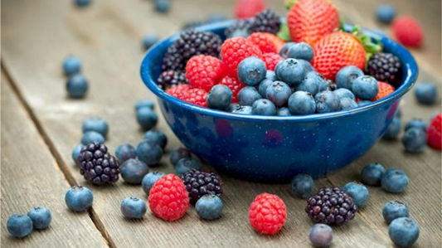
Growing/School Grounds -Meal Barrow competition
We began growing our own meal…
We entered the Meal Barrow competition

Slide 10
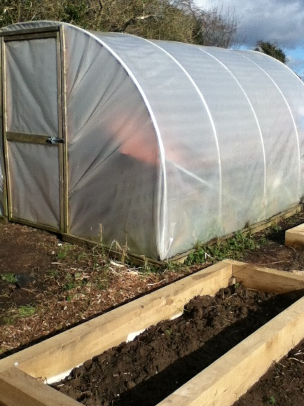
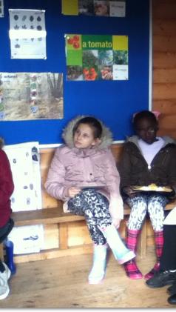
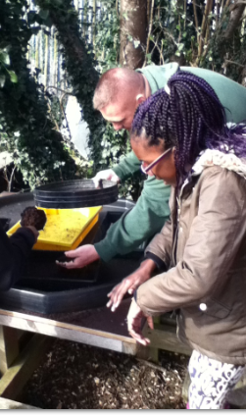
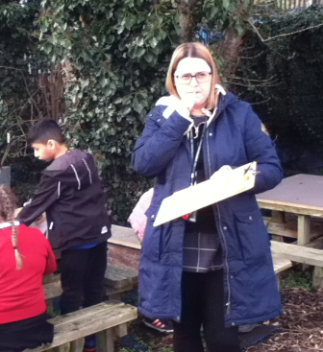
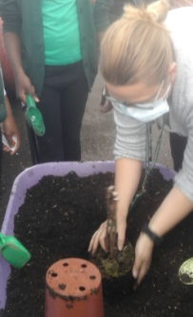
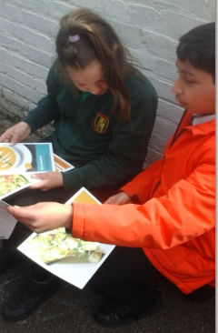
Growing/School Grounds -Little Green Growers

Slide 11
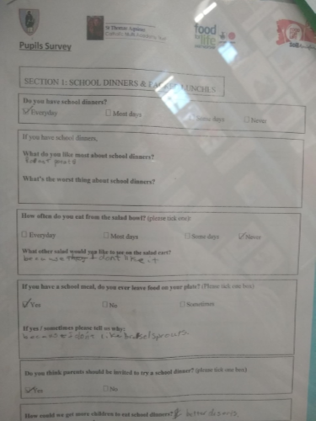
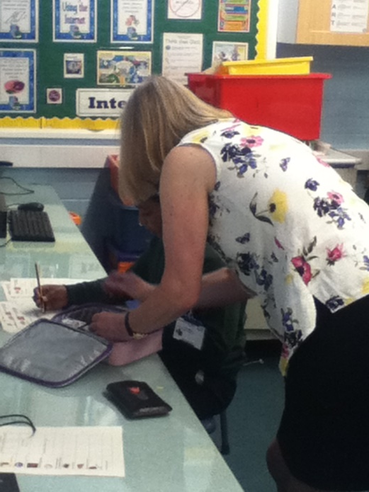
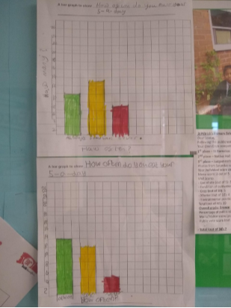
We completed a lunch box audit together with the help of Food for Life and collated all of our results. We made clear graphs to show areas of strength and areas for development.
We carried out a pupil survey asking for suggestions on how to improve lunchtimes and asked for help with ideas to improve our healthy eating around school.

Slide 12
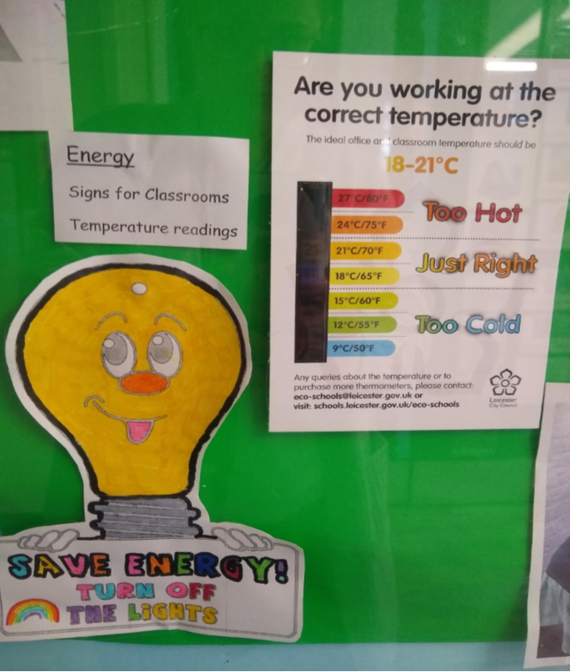
Together we made energy saving signs for around school and made sure all classrooms had temperature charts

Slide 13
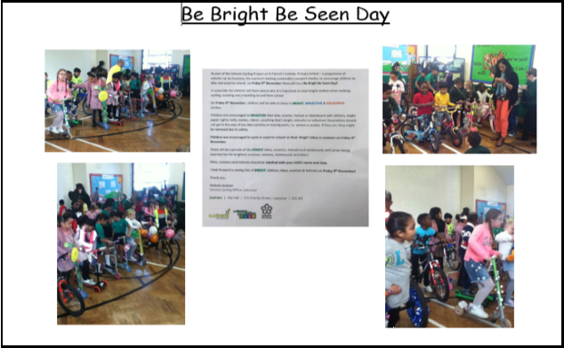
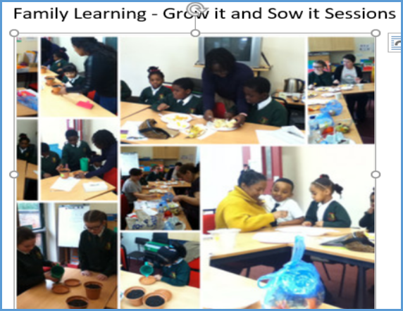
Linking Eco Schools
to our school curriculum
Activities across the school promoting our Eco-school work

Slide 14
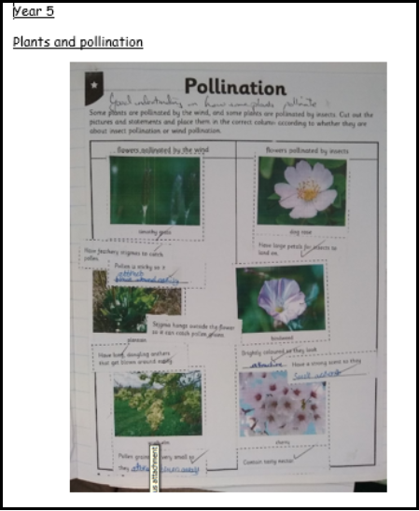

Slide 15
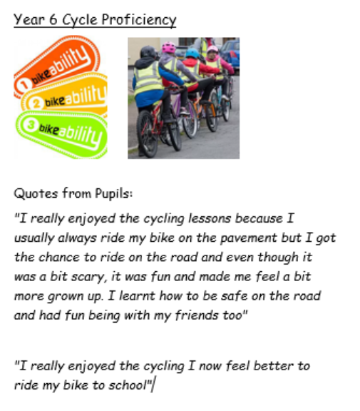
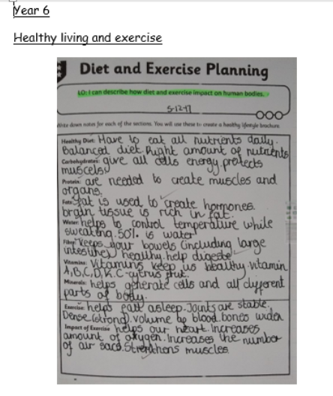

Slide 16
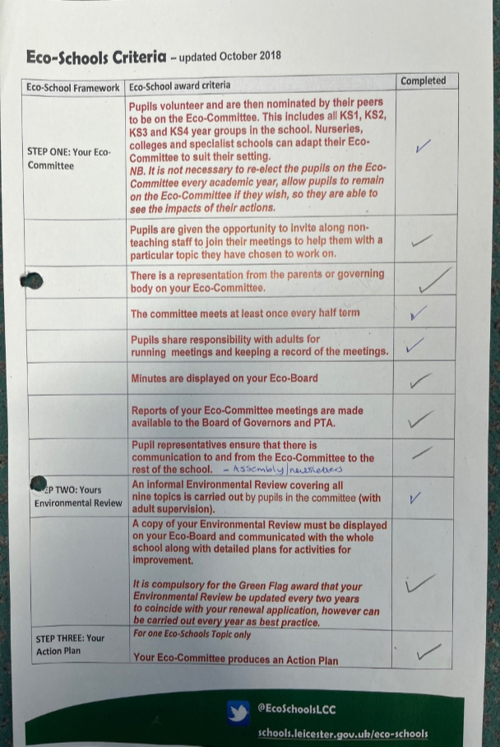
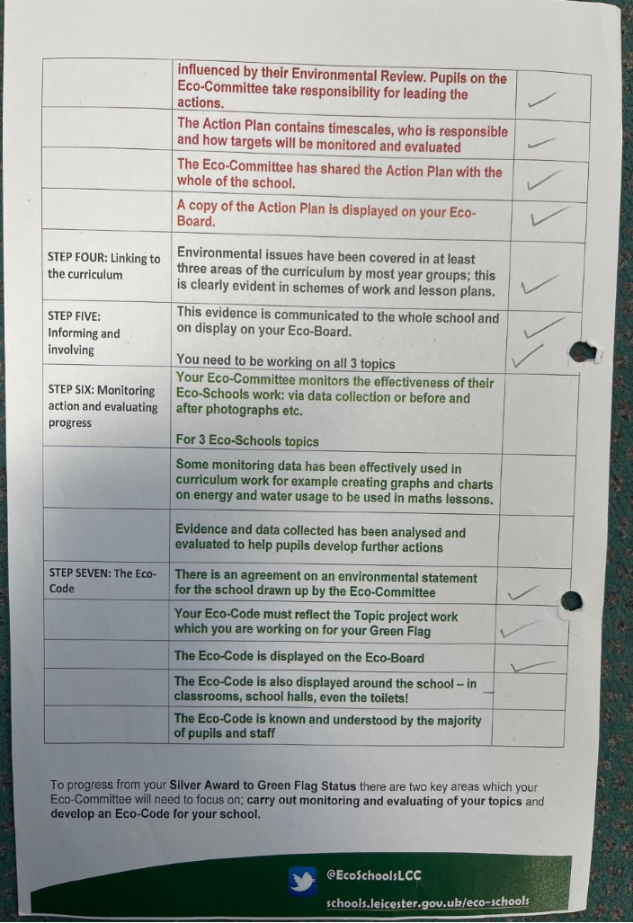
Our evidence which was submitted for the award process

Slide 17
